Slide 1
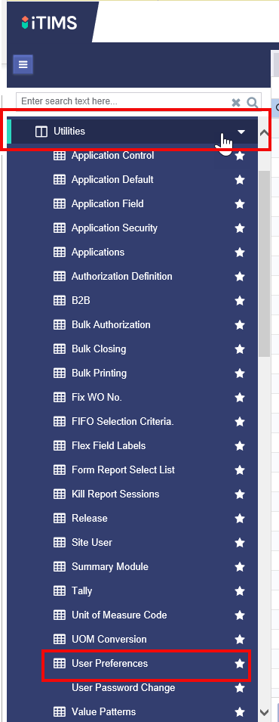
XGEN User Preferences
This PowerPoint will walk through how to update your user preferences (how legacy forms display within XGEN)
1. Under the utilities menu select the ‘User Preferences’ tab

Slide 2
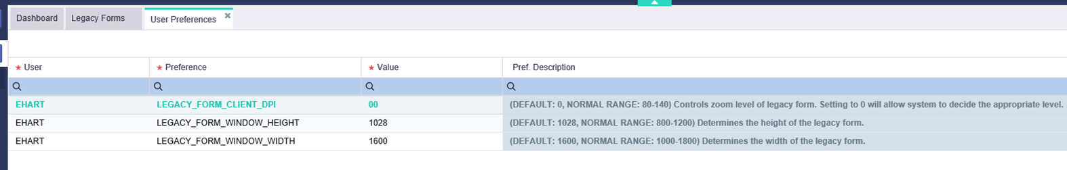
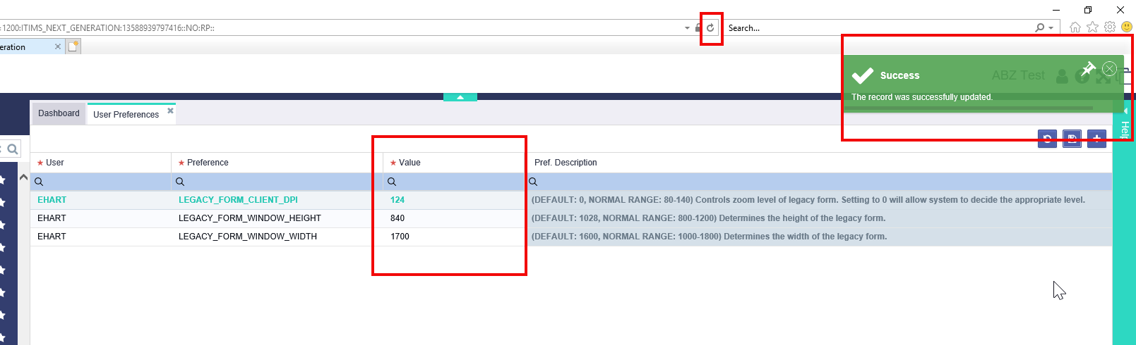
2. Each user must now adjust the default values through a process of trial and error to see which best fit their display. Default values are given, as well as a normal range (suggested range). Once a value is updated and saved, users must hit the browser refresh button and reload the page to see the new changes. See next slide for further information about display options

Slide 3

There are three different values that go into making your legacy display: DPI, Height, Width
Row Name | Description | Notes | Suggested Values
LEGACY_FORM_CLIENT_DPI | Controls zoom level of legacy form. Setting to 0 will allow system to decide the appropriate level | By default every users setting will be 0. This will allow the XGen application to determine the most appropriate zoom setting. The user can control this by entering their own value, with common range being 80-140. They can set it back to 0 at anytime to revert to default. | DEFAULT: 0 NORMAL RANGE: 80-140
LEGACY_FORM_WINDOW_HEIGHT | Determines the height of the legacy form | The default is 1028 pixels high. The user can control this by directly changing the value, with common range being 800-1200. | DEFAULT: 1028 NORMAL RANGE: 800-1200
LEGACY_FORM_WINDOW_WIDTH | Determines the width of the legacy form. | The default is 1600 pixels wide. The user can control this by directly changing the value, with common range being 1000-1800. | DEFAULT: 1600 NORMAL RANGE: 1000-1800

Slide 4
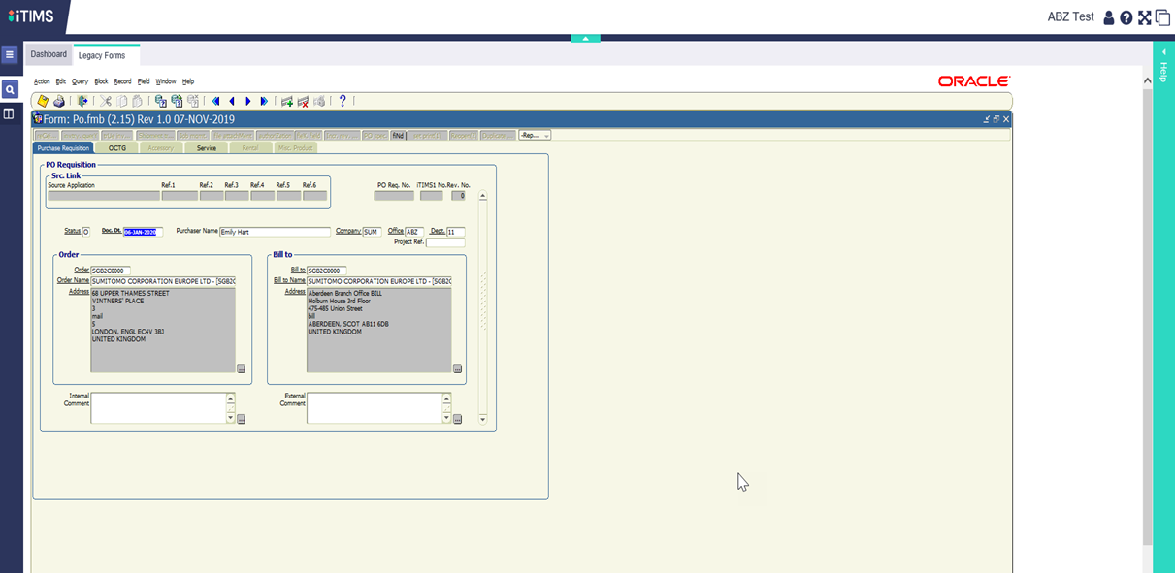
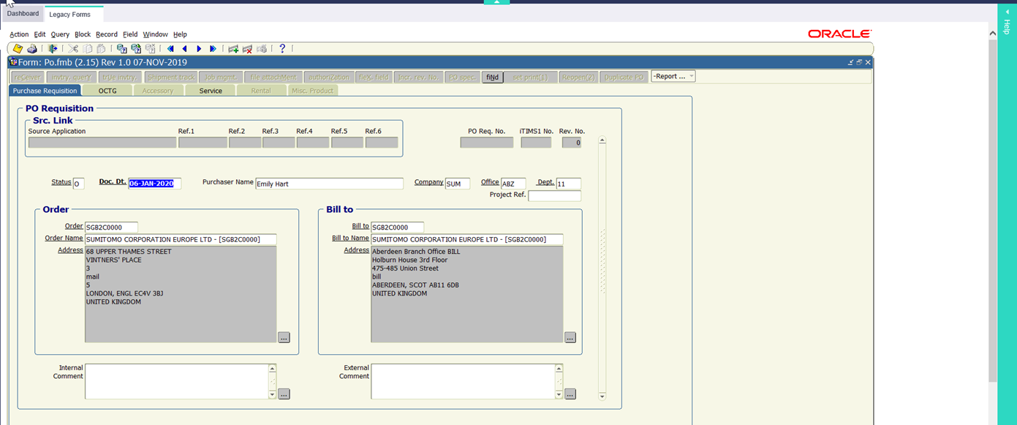
3. DPI- Changing the DPI will change the zoom of the legacy form. For example increasing from 80 to 120 will ZOOM IN the system giving you the below results
DPI 80 (zoomed out)
DPI 120 (zoomed in)

Slide 5
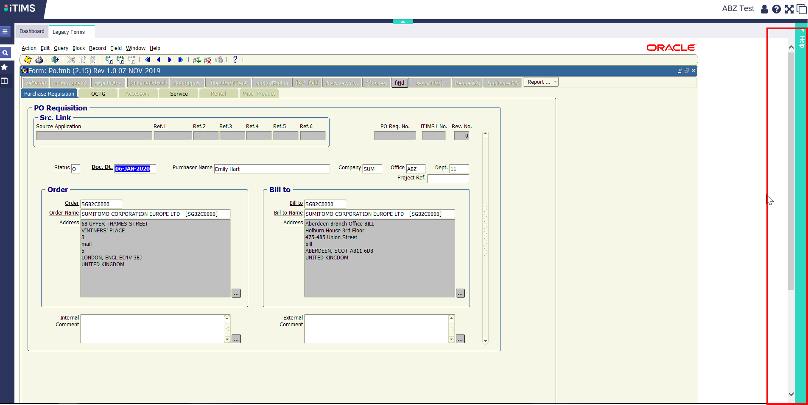
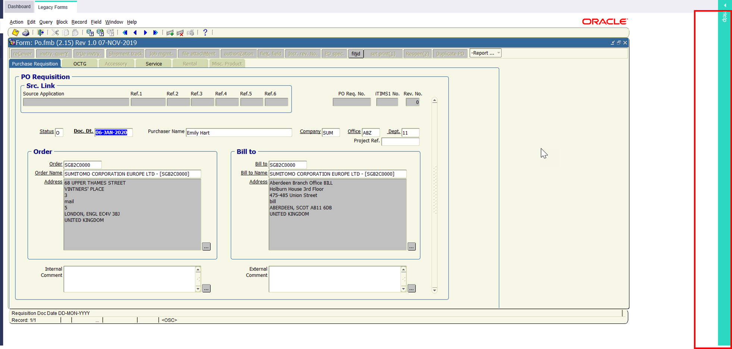
4. Changing the Height will change how much space the legacy form takes up vertically. For example, changing the height from 1200 to 900 decreases the scroll bar
Height 1200 (scroll bar present)
Height 900 (scroll bar not present)

Slide 6
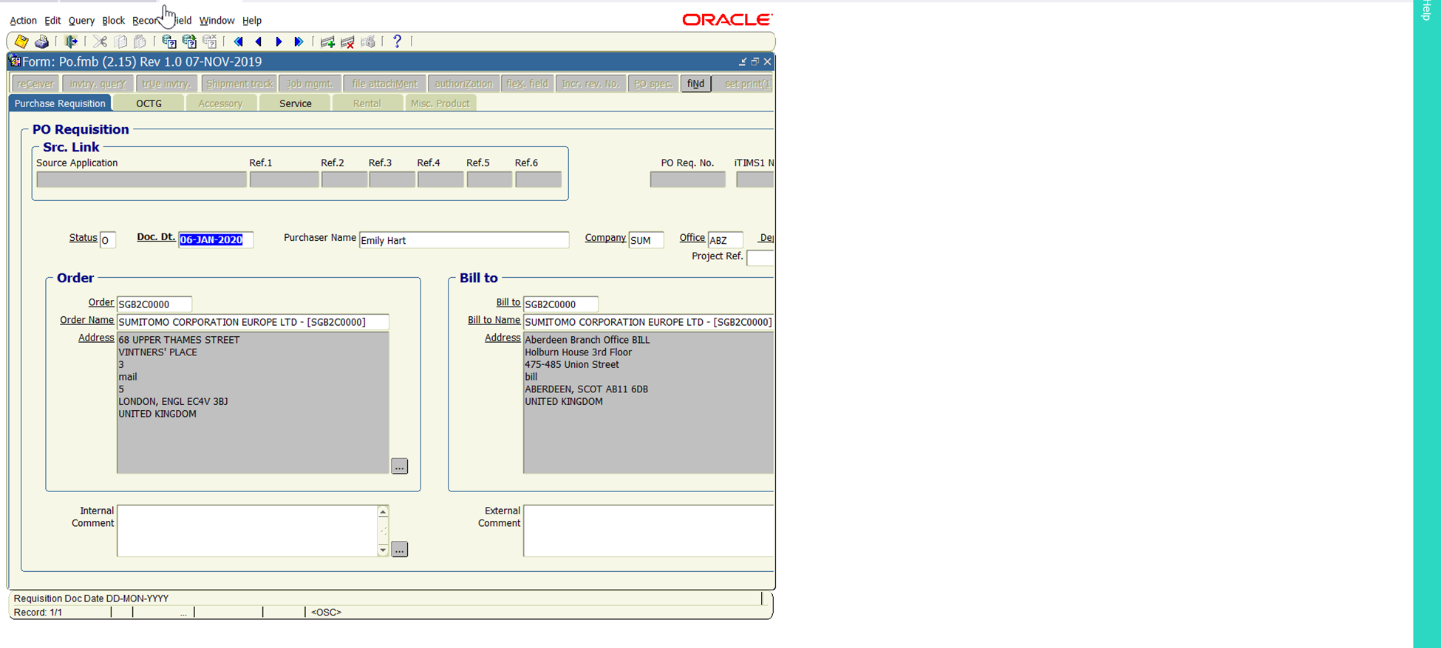
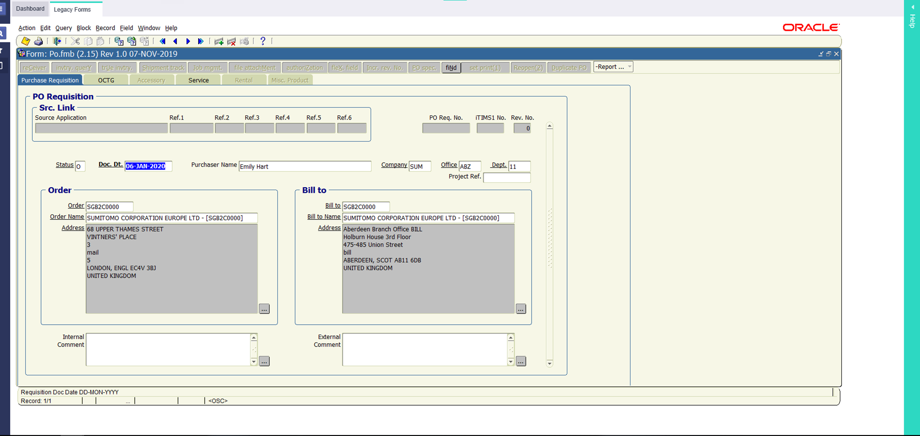
5. Changing the width will change how much space the legacy form takes up horizontally. For example, changing the width from 1000 to 1700 increase the horizontal area
Width 1000 (screen is cut off)
Width 1700 (screen is fully present)

Slide 7
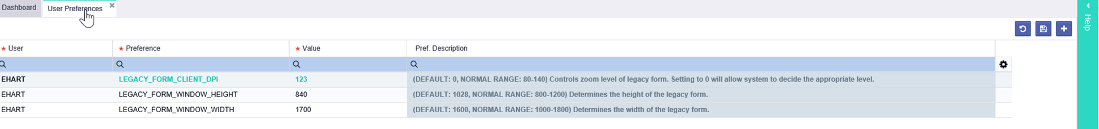
Ultimately every user’s screen and display preference will vary. For my legacy forms to fit my monitor without scrolling, I use the below choices:
FAQ:
Why don’t I see any change in the display even though I updated the User Preferences?
Make sure you have saved the changes AND refreshed the browser, or your changes will not show
I have access to multiple iTIMS sites, will my preferences carry across all my instances?
No, you must reenter your preferences in each iTIMS instance. You can use the same set of numbers, but must reenter them in each instance’s User Preference screen
I use multiple monitors how will this affect my preferences?
Only one set of preferences an be active at a time. If you use multiple monitors (lap top screen and desk monitor for example) you will need to settle on preferences that fit both screens

